Slide 1
Curve Modeling
B-Spline Curves
Dr. S.M. Malaek
Assistant: M. Younesi

Slide 2
Motivation

Slide 3
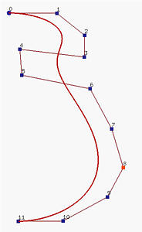
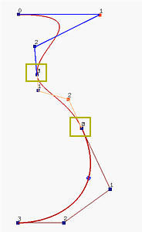
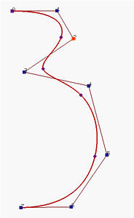
B-Spline Basis: Motivation
Consider designing the profile of a vase.
The left figure below is a Bézier curve of degree 11; but, it is difficult to bend the "neck" toward the line segment P4P5.
The middle figure above uses this idea. It has three Bézier curve segments of degree 3 with joining points marked with yellow rectangles.
The right figure above is a B-spline curve of degree 3 defined by 8 control points .

Slide 4
B-Spline Basis: Motivation
Those little dots subdivide the B-spline curve into curve segments.
One can move control points for modifying the shape of the curve just like what we do to Bézier curves.
We can also modify the subdivision of the curve. Therefore, B-spline curves have higher degree of freedom for curve design.

Slide 5
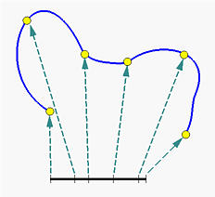
B-Spline Basis: Motivation
Subdividing the curve directly is difficult to do. Instead, we subdivide the domain of the curve.
The domain of a curve is [0,1], this closed interval is subdivided by points called knots.
These knots be 0 <= u₀ <= u₁ <= ... <= u_{m} <= 1.
Modifying the subdivision of [0,1] changes the shape of the curve.

Slide 6
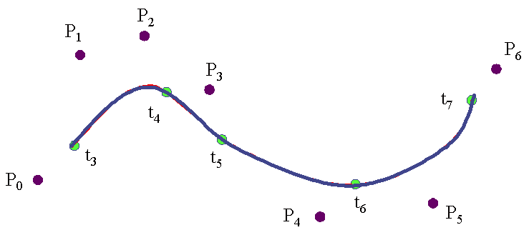
B-Spline Basis: Motivation
In summary :to design a B-spline curve, we need a set of control points, a set of knots and a set of coefficients, one for each control point, so that all curve segments are joined together satisfying certain continuity condition.

Slide 7
B-Spline Basis: Motivation
The computation of the coefficients is perhaps the most complex step because they must ensure certain continuity conditions.

Slide 8
B-Spline Curves

Slide 9
B-Spline Curves
(Two Advantages)
The degree of a B-spline polynmial can be set independently of the number of control points.
B-splines allow local control over the shape of a spline curve (or surface)

Slide 10
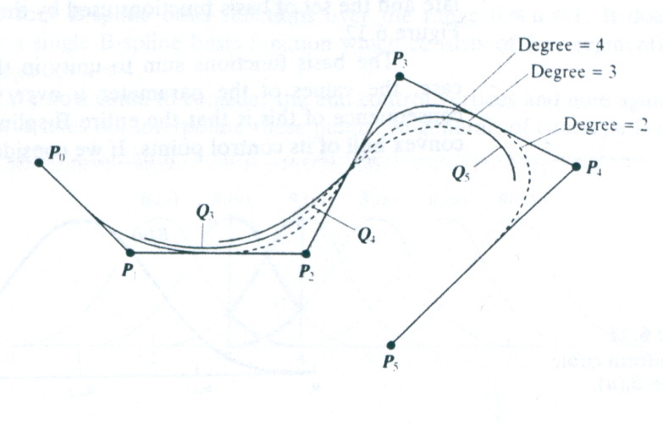
B-Spline Curves
(Two Advantages)
A B-spline curve that is defined by 6 control point, and shows the effect of varying the degree of the polynomials (2,3, and 4)
Q₃ is defined by P₀,P₁,P₂,P₃
Q₄ is defined by P₁,P₂,P₃,P₄
Q₅ is defined by P₂,P₃,P₄,P₅
Each curve segment shares control points.

Slide 11
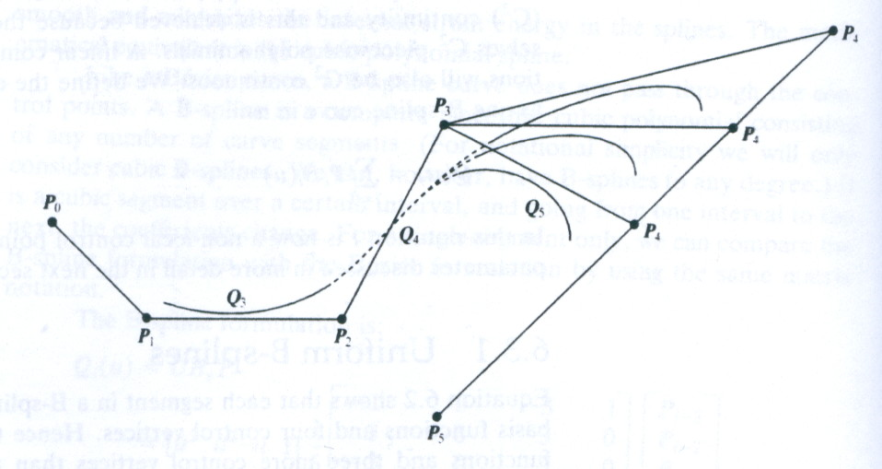
B-Spline Curves
(Two Advantages)
The effect of changing the position of control point P₄ (locality property).

Slide 12
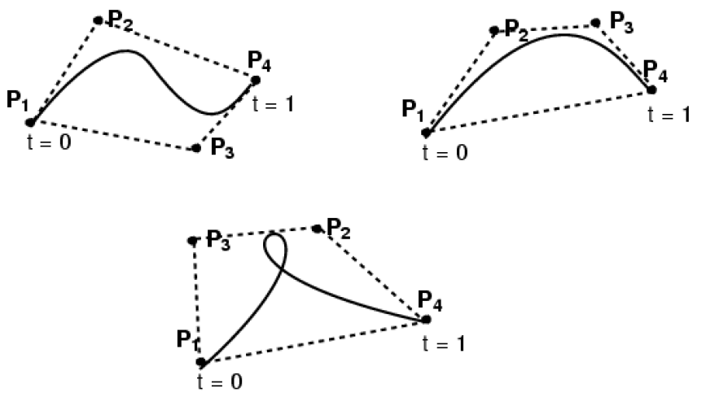
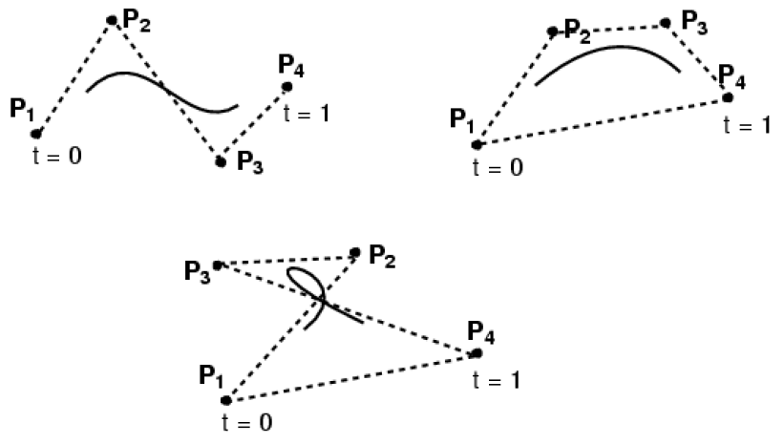
B-Spline Curves
Bézier Curve
B-Spline Curve

Slide 13
B-Spline
Basis Functions

Slide 14
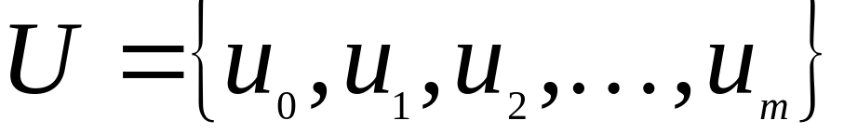
B-Spline Basis Functions
(Knots, Knot Vector)
Let U be a set of m + 1 non-decreasing numbers, u₀ <= u₂ <= u₃ <= ... <= u_{m}. The u_{i}'s are called knots,
The set U is the knot vector.
u₀
u₁
u₄
u₃
u₂
u₅

Slide 15
B-Spline Basis Functions
(Knots, Knot Vector)
The half-open interval [u_{i}, u_{i+1}) is the i-th knot span.
Some u_{i}'s may be equal, some knot spans may not exist.

Slide 16
B-Spline Basis Functions
(Knots)
If a knot u_{i} appears k times (i.e., u_{i} = u_{i+1} = ... = u_{i+k-1}), where k > 1, u_{i} is a multiple knot of multiplicity k, written as u_{i}(k).
If u_{i} appears only once, it is a simple knot.
If the knots are equally spaced (i.e., u_{i+1} - u_{i} is a constant for 0 <= i <= m - 1), the knot vector or the knot sequence is said uniform; otherwise, it is non-uniform.

Slide 17
B-Spline Basis Functions
All B-spline basis functions are supposed to have their domain on [u₀, u_{m}].
We use u₀ = 0 and u_{m} = 1 frequently so that the domain is the closed interval [0,1].

Slide 18
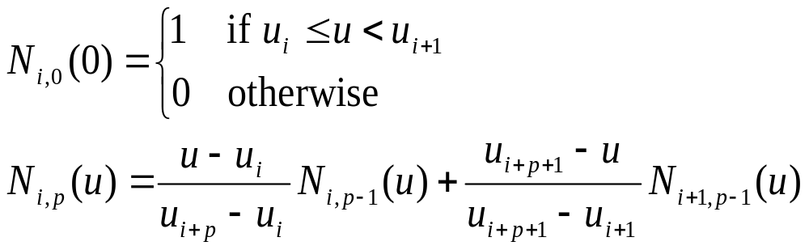
B-Spline Basis Functions
To define B-spline basis functions, we need one more parameter.
The degree of these basis functions, p. The i-th B-spline basis function of degree p, written as N_{i,p}(u), is defined recursively as follows:

Slide 19

B-Spline Basis Functions
The above is usually referred to as the Cox-de Boor recursion formula.
If the degree is zero (i.e., p = 0), these basis functions are all step functions .
basis function N_{i,0}(u) is 1 if u is in the i-th knot span [u_{i}, u_{i+1}).
We have four knots u₀ = 0, u₁ = 1, u₂ = 2 and u₃ = 3, knot spans 0, 1 and 2 are [0,1), [1,2), [2,3) and the basis functions of degree 0 are N_{0,0}(u) = 1 on [0,1) and 0 elsewhere, N_{1,0}(u) = 1 on [1,2) and 0 elsewhere, and N_{2,0}(u) = 1 on [2,3) and 0 elsewhere.

Slide 20
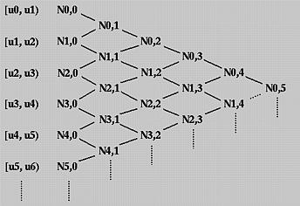
B-Spline Basis Functions
To understand the way of computing N_{i,p}(u) for p greater than 0, we use the triangular computation scheme.

Slide 21

B-Spline Basis Functions
To compute N_{i,1}(u), N_{i,0}(u) and N_{i+1},0(u) are required. Therefore, we can compute N_{0,1}(u), N_{1,1}(u), N_{2,1}(u), N_{3,1}(u) and so on. All of these N_{i,1}(u)'s are written on the third column. Once all N_{i,1}(u)'s have been computed, we can compute N_{i,2}(u)'s and put them on the fourth column. This process continues until all required N_{i,p}(u)'s are computed.

Slide 22

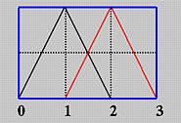
B-Spline Basis Functions
Since u0 = 0, u1 = 1 and u2 = 2, the above becomes

Slide 23



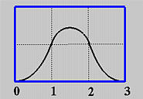
B-Spline Basis Functions
u is in [0,1): In this case, only N0,1(u) contributes to the value of N0,2(u). Since N0,1(u) is u, we have
u is in [1,2) :In this case, both N0,1(u) and N1,1(u) contribute to N0,2(u). Since N0,1(u) = 2 - u and N1,1(u) = u - 1 on [1,2), we have
u is in [2,3): In this case, only N1,1(u) contributes to N0,2(u). Since N1,1(u) = 3 - u on [2,3), we have

Slide 24
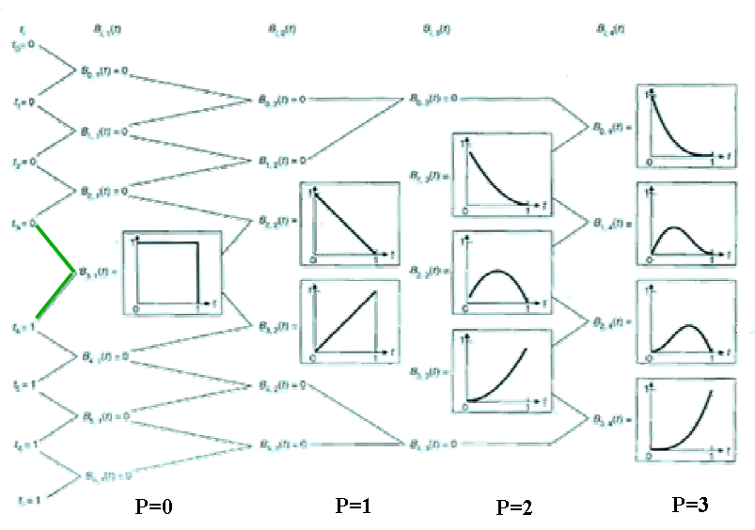
B-Spline Basis Functions

Slide 25
Two Important Observation

Slide 26
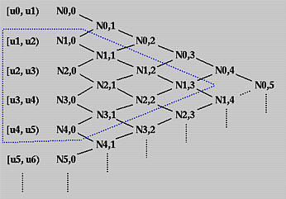
Two Important Observation
Basis function N_{i,p}(u) is non-zero on [u_{i}, u_{i+p+1}). Or, equivalently, N_{i,p}(u) is non-zero on p+1 knot spans [u_{i}, u_{i+1}), [u_{i+1}, u_{i+2}), ..., [u_{i+p}, u_{i+p+1}).

Slide 27
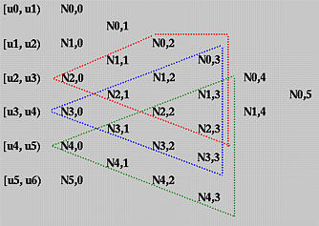
Two Important Observation
On any knot span [u_{i}, u_{i+1}), at most p+1 degree p basis functions are non-zero, namely: N_{i-p,p}(u), N_{i-p+1,p}(u), _{Ni-p+2,p(u}), ..., N_{i-1,p}(u) and N_{i,p}(u),

Slide 28
B-Spline Basis Functions
(Important Properties )

Slide 29
B-Spline Basis Functions
(Important Properties )
N_{i,p}(u) is a degree p polynomial in u.
Nonnegativity -- For all i, p and u, N_{i,p}(u) is non-negative
Local Support -- N_{i,p}(u) is a non-zero polynomial on [u_{i,}u_{i+p+1})

Slide 30
B-Spline Basis Functions
(Important Properties )
On any span [u_{i}, u_{i+1}), at most p+1 degree p basis functions are non-zero, namely: N_{i-p},_{p}(u), N_{i-p+1,p}(u), N_{i-p+2,p}(u), ..., and N_{i,p}(u) .
The sum of all non-zero degree p basis functions on span [u_{i}, u_{i+1}) is 1.
If the number of knots is m+1, the degree of the basis functions is p, and the number of degree p basis functions is n+1, then m = n + p + 1

Slide 31
B-Spline Basis Functions
(Important Properties )
Basis function N_{i,p}(u) is a composite curve of degree p polynomials with joining points at knots in [u_{i}, u_{i+p+1} )
At a knot of multiplicity k, basis function N_{i,p}(u) is C^{p-k} continuous.
Increasing multiplicity decreases the level of continuity, and increasing degree increases continuity.

Slide 32
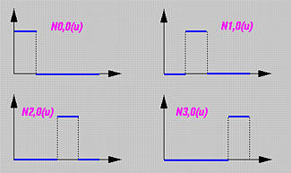
B-Spline Basis Functions
(Computation Examples)
Simple Knots
Suppose the knot vector is U = { 0, 0.25, 0.5, 0.75, 1 }.
Basis functions of degree 0: N_{0,0}(u), N_{1,0}(u), N_{2,0}(u) and N_{3,0}(u) defined on knot span [0,0.25,), [0.25,0.5), [0.5,0.75) and [0.75,1), respectively.

Slide 33
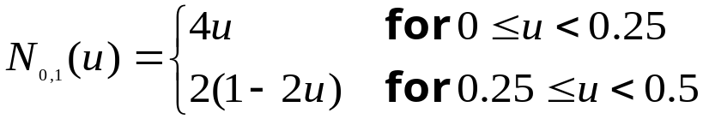

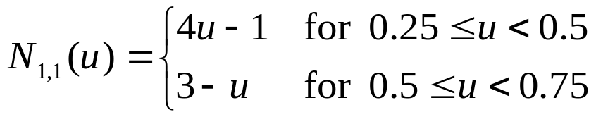
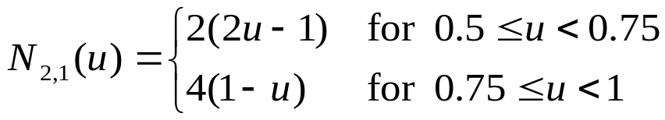
B-Spline Basis Functions
(Computation Examples)
All Ni,1(u)'s (U = { 0, 0.25, 0.5, 0.75, 1 }(:
Since the internal knots 0.25, 0.5 and 0.75 are all simple (i.e., k = 1) and p = 1, there are p - k + 1 = 1 non-zero basis function and three knots. Moreover, N_{0,1}(u), N_{1,1}(u) and N_{2,1}(u) are C⁰ continuous at knots 0.25, 0.5 and 0.75, respectively.

Slide 34
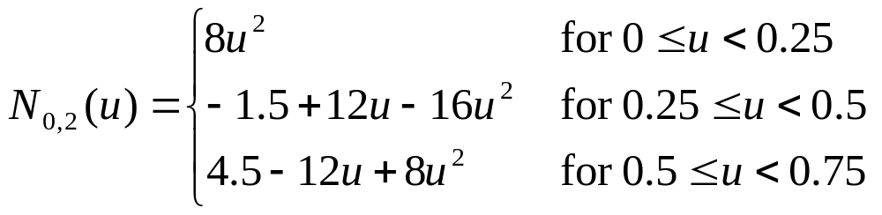

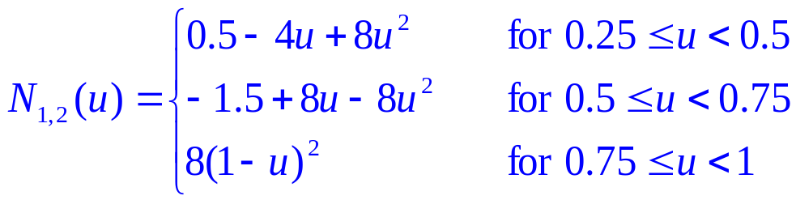
B-Spline Basis Functions
(Computation Examples)
From N_{i,1}(u)'s, one can compute the basis functions of degree 2. Since m = 4, p = 2, and m = n + p + 1, we have n = 1 and there are only two basis functions of degree 2: N_{0,2}(u) and N_{1,2}(u). (U = { 0, 0.25, 0.5, 0.75, 1 }(:
each basis function is a composite curve of three degree 2 curve segments.
composite curve is of C¹ continuity

Slide 35
B-Spline Basis Functions (Computation Examples)
Knots with Positive Multiplicity :
Suppose the knot vector is U = { 0, 0, 0, 0.3, 0.5, 0.5, 0.6, 1, 1, 1{
Since m = 9 and p = 0 (degree 0 basis functions), we have n = m - p - 1 = 8. there are only four non-zero basis functions of degree 0: N_{2,0}(u), N_{3,0}(u), N_{5,0}(u) and N_{6,0}(u).

Slide 36
B-Spline Basis Functions
(Computation Examples)
Basis functions of degree 1: Since p is 1, n = m - p - 1 = 7. The following table shows the result
Basis Function | Range | Equation
N_{0,1(u)} | all u | 0
N_{1,1(u)} | [0, 0.3) | 1 - (10/3)u
N_{2,1(u)} | [0, 0.3) | (10/3)u
 | [0.3, 0.5) | 2.5(1 - 2u)
N_{3,1(u)} | [0.3, 0.5) | 5u - 1.5
N_{4,1(u)} | [0.5, 0.6) | 6 - 10u
N_{5,1(u)} | [0.5, 0.6) | 10u - 5
 | [0.6, 1) | 2.5(1 - u)
N_{6,1(u)} | [0.6, 1) | 2.5u - 1.5
N_{7,1(u)} | all u | 0

Slide 37
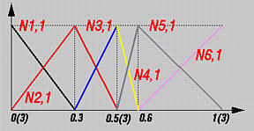
B-Spline Basis Functions
(Computation Examples)
Basis functions of degree 1:

Slide 38
B-Spline Basis Functions
(Computation Examples)
Since p = 2, we have n = m - p - 1 = 6. The following table contains all Ni,2(u)'s:
Function | Range | Equation
N_{0,2}(u) | [0, 0.3) | (1 - (10/3)u)²
N_{1,2}(u) | [0, 0.3) | (20/3)(u - (8/3)u²)
 | [0.3, 0.5) | 2.5(1 - 2u)²
N_{2,2}(u) | [0, 0.3) | (20/3)u²
 | [0.3, 0.5) | -3.75 + 25u - 35u²
N_{3,2}(u) | [0.3, 0.5) | (5u - 1.5)²
 | [0.5, 0.6) | (6 - 10u)²
N_{4,2}(u) | [0.5, 0.6) | 20(-2 + 7u - 6u²)
 | [0.6, 1) | 5(1 - u)²
N_{5,2}(u) | [0.5, 0.6) | 12.5(2u - 1)²
 | [0.6, 1) | 2.5(-4 + 11.5u - 7.5u²)
N_{6,2}(u) | [0.6, 1) | 2.5(9 - 30u + 25u²)

Slide 39
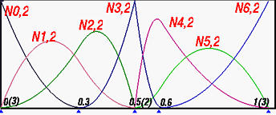
B-Spline Basis Functions
(Computation Examples)
Basis functions of degree 2:
U = { 0, 0, 0, 0.3, 0.5, 0.5, 0.6, 1, 1, 1{
Since its multiplicity is 2 and the degree of these basis functions is 2, basis function N_{3,2}(u) is C⁰ continuous at 0.5(2). This is why N_{3,2}(u) has a sharp angle at 0.5(2).
For knots not at the two ends, say 0.3 and 0.6, C¹ continuity is maintained since all of them are simple knots.

Slide 40
B-Spline
Curves

Slide 41
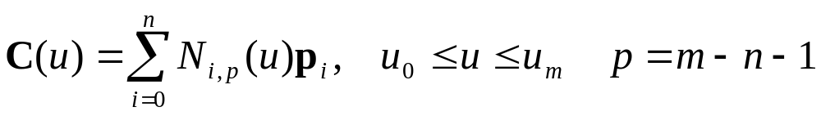
B-Spline Curves
(Definition)
Given n + 1 control points P₀, P₁, ..., P_{n} and a knot vector U = { u₀, u₁, ..., u_{m} }, the B-spline curve of degree p defined by these control points and knot vector U is
The point on the curve that corresponds to a knot u_{i}, C(u_{i}), is referred to as a knot point.
The knot points divide a B-spline curve into curve segments, each of which is defined on a knot span.

Slide 42
B-Spline Curves
(Definition)
The degree of a B-spline basis function is an input.
To change the shape of a B-spline curve, one can modify one or more of these control parameters:
The positions of control points
The positions of knots
The degree of the curve

Slide 43
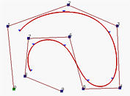
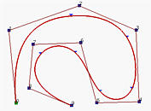
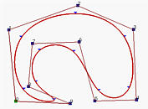
(Open, Clamped & Closed B-Spline Curves)
Open B-spline curves: If the knot vector does not have any particular structure, the generated curve will not touch the first and last legs of the control polyline.
Clamped B-spline curve: If the first knot and the last knot multiplicity p+1, curve is tangent to the first and the last legs at the first and last control polyline, as a Bézier curve does.
Closed B-spline curves: By repeating some knots and control points, the generated curve can be a closed one. In this case, the start and the end of the generated curve join together forming a closed loop.
Open B-Spline
Clamped B-Spline
Closed B-Spline
control points (n=9) and p = 3. m must be 13 so that the knot vector has 14 knots. To have the clamped effect, the first p+1 = 4 and the last 4 knots must be identical. The remaining 14 - (4 + 4) = 6 knots can be anywhere in the domain. In fact, the curve is generated with knot vector U = { 0, 0, 0, 0, 0.14, 0.28, 0.42, 0.57, 0.71, 0.85, 1, 1, 1, 1 }.

Slide 44
Open
B-Spline Curves

Slide 45
Open B-Spline Curves
Recall from the B-spline basis function property that on a knot span [u_{i}, u_{i+1}), there are at most p+1 non-zero basis functions of degree p.
For open B-spline curves, the domain is [u_{p}, u_{m-p}].

Slide 46
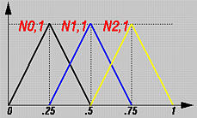
Open B-Spline Curves
Example 1:
knot vector U = { 0, 0.25, 0.5, 0.75, 1 }, where m = 4. If the basis functions are of degree 1 (i.e., p = 1), there are three basis functions N_{0,1}(u), N_{1,1}(u) and N_{2,1}(u).
Since this knot vector is not clamped, the first and the last knot spans (i.e., [0, 0.25) and [0.75, 1)) have only one non-zero basis functions while the second and third knot spans (i.e., [0.25, 0.5) and [0.5, 0.75)) have two non-zero basis functions.

Slide 47
Open B-Spline Curves
Example 2:

Slide 48
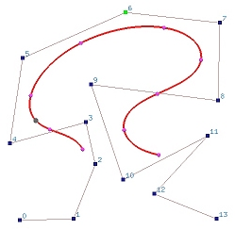
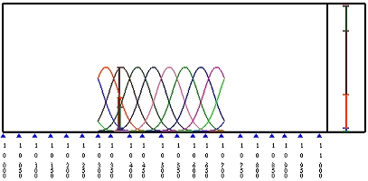
Open B-Spline Curves
Example 3:
A B-spline curve of degree 6 (i.e., p = 6) defined by 14 control points (i.e., n = 13). The number of knots is 21 (i.e., m = n + p + 1 = 20).
If the knot vector is uniform, the knot vector is }0, 0.05, 0.10, 0.15, ..., 0.90, 0.95,10{. The open curve is defined on [u_{p}, u_{m-p}] = [u₆, u₁₄] = [0.3, 0.7] and is not tangent to the first and last legs.

Slide 49
Clamped
B-Spline Curves

Slide 50
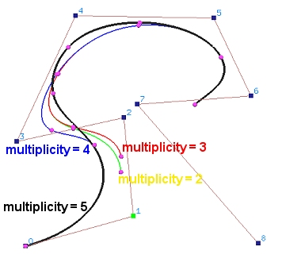
Clamped B-Spline Curves
We use an exampleuse to illustrate the change between an open curve and a clamped one:
An open B-spline curve of degree 4 , n = 8 and a uniform knot vector { 0, 1/13, 2/13, 3/13, ..., 12/13, 1 }.
Multiplicity 5 (i.e., p+1),(second, third, fourth and fifth knot to 0 ) the curve not only passes through the first control point but also is tangent to the first leg of the control polyline.

Slide 51
Closed
B-Spline Curves

Slide 52
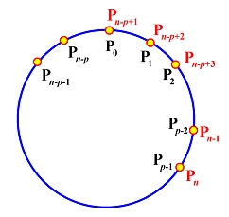
Closed B-Spline Curves
To construct a closed B-spline curve C(u) of degree p defined by n+1 control points ,the number of knots is m+1, We must:
Design an uniform knot sequence of m+1 knots: u₀ = 0, u₁ = 1/m, u₂ = 2/m, ..., u_{m} = 1. Note that the domain of the curve is [u_{p}, u_{n-p}].
Wrap the first p and last p control points. More precisely, let P₀ = P_{n-p+1}, P₁ = P_{n-p+2}, ..., P_{p-2} = P_{n-1} and P_{p-1} = P_{n}.

Slide 53
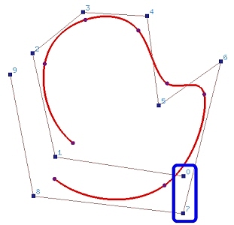
Closed B-Spline Curves
Example. Figure (a) shows an open B-spline curve of degree 3 defined by 10 (n = 9) control points and a uniform knot vector.
In the figure, control point pairs 0 and 7, Figure (b), 1 and 8, Figure (c), and 2 and 9, Figure (d) are placed close to each other to illustrate the construction.
a

Slide 54
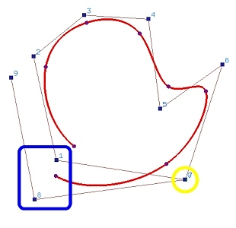
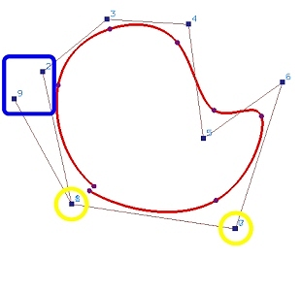
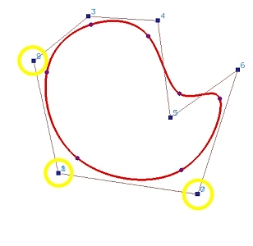
Closed B-Spline Curves
a
b
c
d

Slide 55
B-Spline Curves
Important Properties

Slide 56
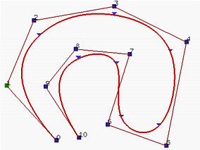
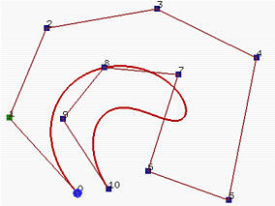
B-Spline Curves Important Properties
B-spline curve C(u) is a piecewise curve with each component a curve of degree p.
ٍExample: where n = 10, m = 14 and p = 3, the first four knots and last four knots are clamped and the 7 internal knots are uniformly spaced. There are 8 knot spans, each of which corresponds to a curve segment.
Clamped B-Spline Curve
Bézier Curve (degree 10!)

Slide 57
B-Spline Curves Important Properties
Equality m = n + p + 1 must be satisfied.
Clamped B-spline curve C(u) passes through the two end control points P₀ and P_{n}.
Strong Convex Hull Property: A B-spline curve is contained in the convex hull of its control polyline.

Slide 58
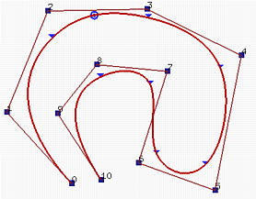
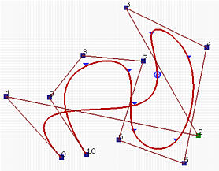
B-Spline Curves Important Properties
Local Modification Scheme: changing the position of control point Pi only affects the curve C(u) on interval [u_{i}, u_{i+p+1}).
The right figure shows the result of moving P₂ to the lower right corner. Only the first, second and third curve segments change their shapes and all remaining curve segments stay in their original place without any change.

Slide 59
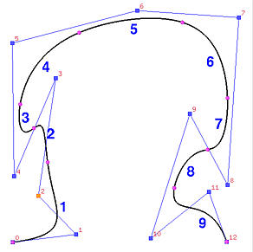
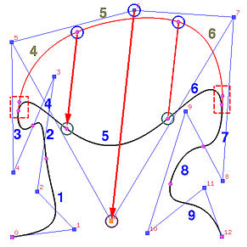
B-Spline Curves Important Properties
A B-spline curve of degree 4 defined by 13 control points and 18 knots .
Move P₆.
The coefficient of P₆ is N_{6,4}(u), which is non-zero on [u₆, u₁₁). Thus, moving P6 affects curve segments 3, 4, 5, 6 and 7. Curve segments 1, 2, 8 and 9 are not affected.

Slide 60
B-Spline Curves Important Properties
C(u) is C^{p-k} continuous at a knot of multiplicity k
Affine Invariance

